Slide 1
3D Image Segmentation and Quantification of Lysosomes
2nd meeting 15/09/2025

Slide 2
OUTPUT
Metrics-lysosomes
Segmentation
DATASETS
Size
Number of lysosomes.
Localization of lysosomes in the cell.

Slide 3
How does the code calculate the radius, diameter and volume?
Method Blob log
Blobs are found using the Laplacian of Gaussian (LoG) method .For each blob found, the method returns its coordinates and the standard deviation of the Gaussian kernel that detected the blob.Searches for roughly bright, roughly spherical spots across scales.
Laplacian of Gaussian (LoG)
It computes the Laplacian of Gaussian images with successively increasing standard deviation and stacks them up in a cube. Blobs are local maximas in this cube.
For a 3D image → blobs.shape = (N, 4) with columns (z, y, x, sigma).

Slide 4
How does the code calculate the radius, diameter and volume?
Only if any blobs found, convert scale to an approximate radius.
For a 3D image → blobs.shape = (N, 4) with columns (z, y, x, sigma).
σ (sigma) in the Gaussian kernel controls the amount of smoothing before applying the Laplacian operator.
A blob of radius r will be detected best when σ ≈ r / √d, where d = dimension (2 for 2D, 3 for 3D).
In 3D, radius ≈ √3 × σ
It get an estimate of the blob radius in voxels.

Slide 5
Segmentation of cells
Meijering filter
This filter can be used to detect continuous ridges, e.g. neurons, neurites, wrinkles, rivers. It can be used to calculate the fraction of the whole image containing such objects.
Calculates the eigenvalues of the Hessian to compute the similarity of an image region to neurons.
https://scikit-image.org/docs/0.23.x/api/skimage.filters.html#skimage.filters.meijering
Ridge operators
It can be used to detect ridge-like structures, such as neurons, neurites,tubes, vessels, wrinkles or rivers.
Different ridge filters may be suited for detecting different structures, e.g., depending on contrast or noise level.
The present class of ridge filters relies on the eigenvalues of the Hessian matrix of image intensities to detect ridge structures where the intensity changes perpendicular but not along the structure.
https://scikit-image.org/docs/0.23.x/auto_examples/edges/plot_ridge_filter.html#id5
Threshold local
Compute an adaptive (local) threshold for this slice.

Slide 6
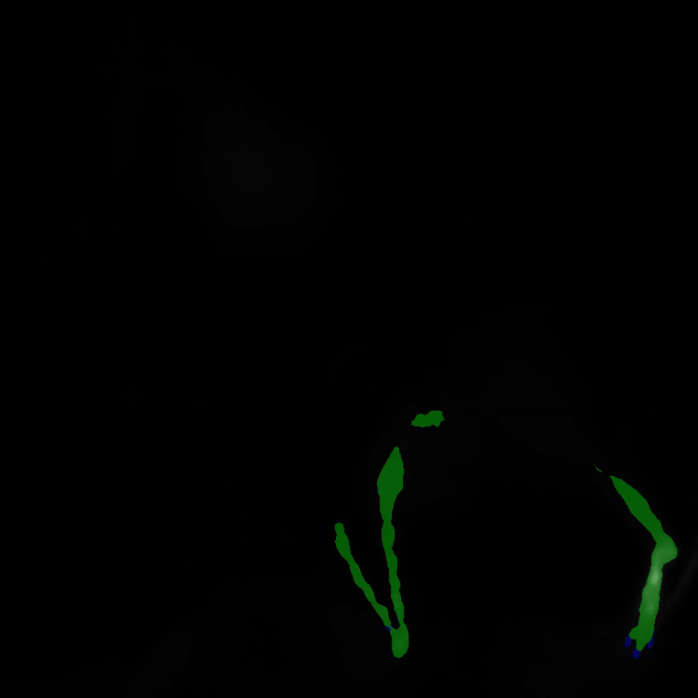
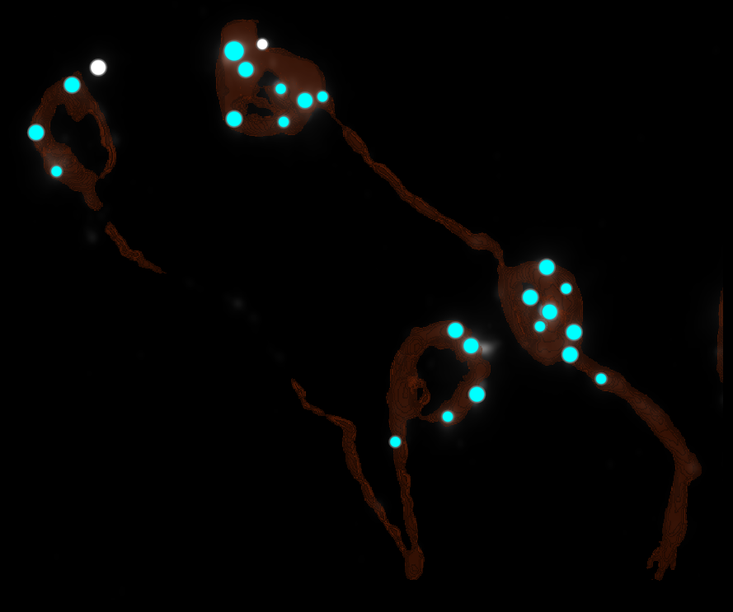
SEGMENTATION

Slide 7
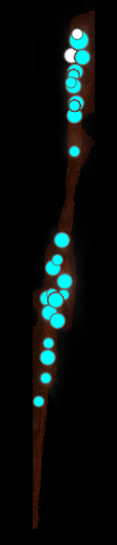
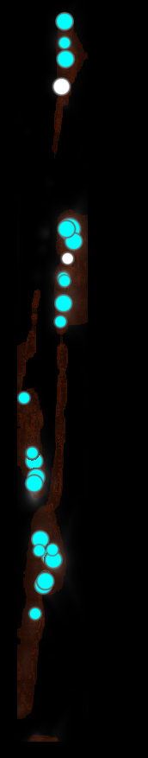
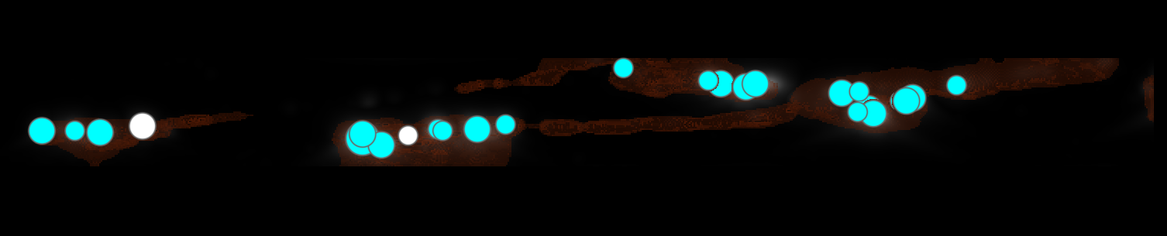
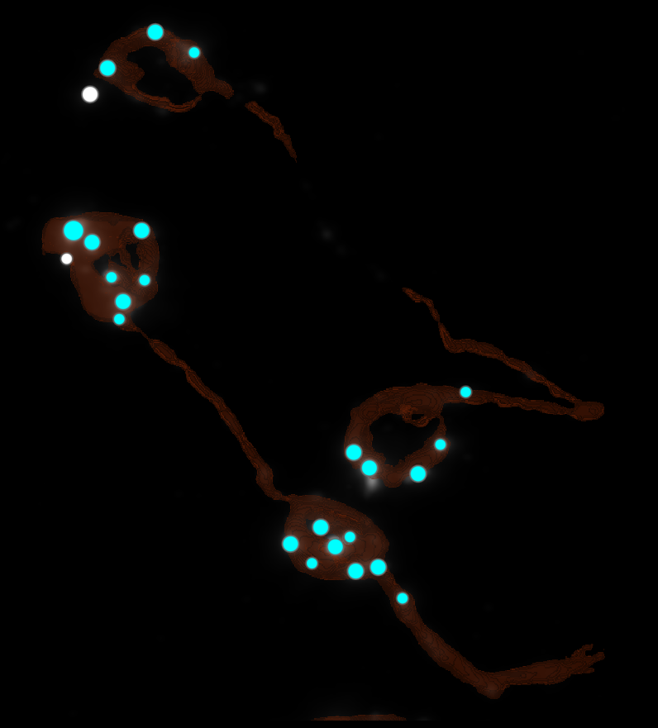
Topographic map

Slide 8
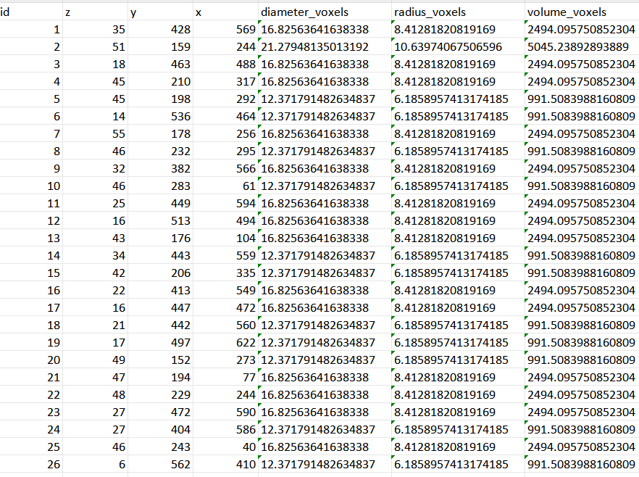
DATASETS(Metrics-lysosomes)
NUMBER OF LYSOSOMES
26

Slide 9
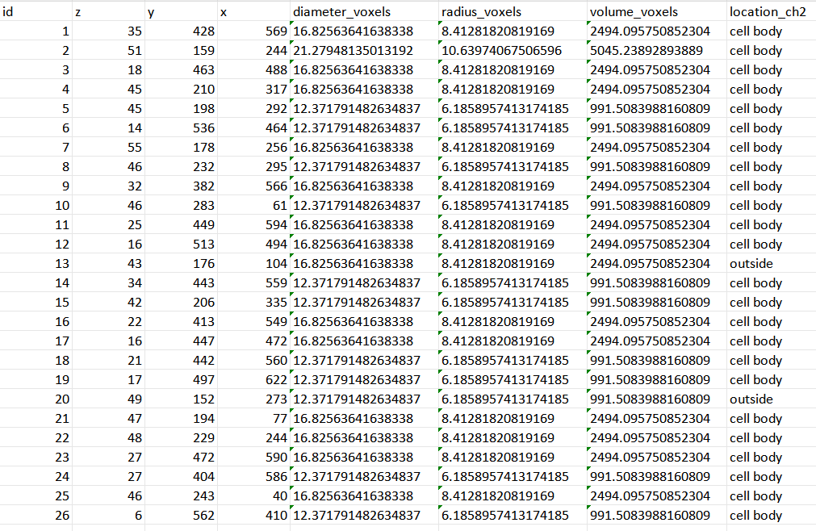

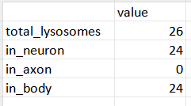
DATASETS(Localization of lysosomes in the cell)

Slide 10
NEXT STAGES
Continue improving cell segmentation.
Continue improving the signal fit to determine the real dimensions of cell bodies, cell axes, and lysosomes.
Converting pixel measurements to nanometers.

Slide 11
Questions?

